Slide 1
Human Perception

Slide 2
Human Perception
Human Perception is highly subjective, it can depend on
  Past experience
  Context

Slide 3
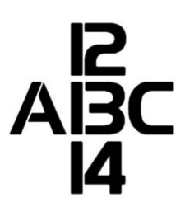
Role of Context in Perception

Slide 4
Gestalt Laws
The Gestalt Laws of Perception help explain how humans perceive and make sense of visual information.

Slide 5
Gestalt Laws
is a German word that means roughly means “shape”, “form”, “essence”, or “whole”

Slide 6
Gestalt Principle
According to Gestalt principle when we are presented with a complex visual image, our minds recognize coherent, whole forms, rather than individually perceiving all of the smaller constituent parts that make up the image.

Slide 7
Gestalt Principles
Figure-Ground
Similarity
Proximity
"Common Fate"
Closure
Focal Point
Symmetry

Slide 8
Figure - Ground
We have to determine which elements are figures (requiring immediate concern and attention) and which are ground (not so important right now, but do provide context)

Slide 9
Figure - Ground
In short it allows us to determine what we’re supposed to look at and what we might safely ignore.
Foreground objects should be more prominent than their backgrounds.

Slide 10
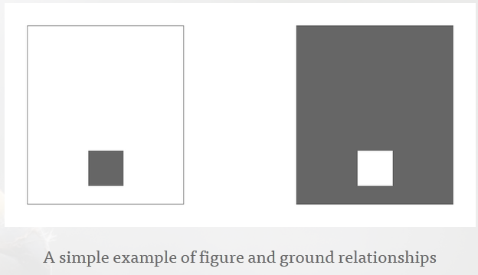
Figure - Ground
http://www.andyrutledge.com/gestalt-principles-1-figure-ground-relationship.php

Slide 11
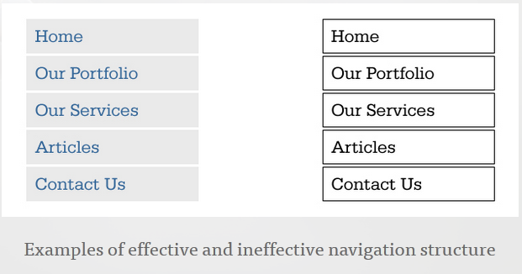
Figure - Ground
http://www.andyrutledge.com/gestalt-principles-1-figure-ground-relationship.php
In this case, lines are perceived to be content,
so the structure competes with the content.
The result is distracting.

Slide 12
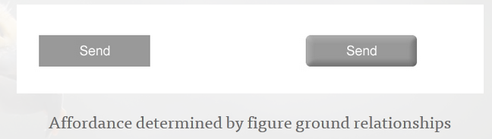
Figure - Ground
http://www.andyrutledge.com/gestalt-principles-1-figure-ground-relationship.php

Slide 13
Figure - Ground
There’s more to the figure-ground principle than just using appropriately unobtrusive backgrounds.
The contrast between the figure (foreground object) and the ground (background) makes for interesting graphics and logos.

Slide 14
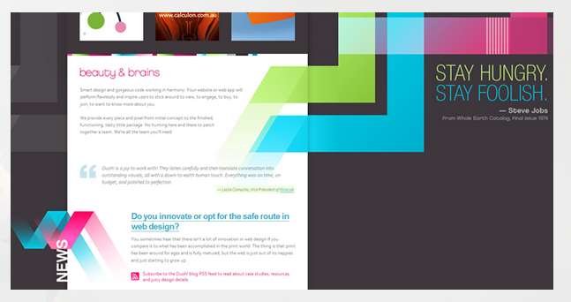
Figure - Ground
http://www.andyrutledge.com/gestalt-principles-1-figure-ground-relationship.php

Slide 15


Figure - Ground
http://sixrevisions.com/web_design/gestalt-principles-applied-in-design/

Slide 16
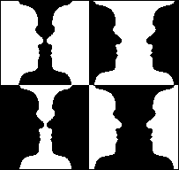
Figure-Ground

Slide 17
Similarity
Similarity is a powerful mechanism for communication.
There are many ways in which objects can be considered to be similar.
We will look at different examples

Slide 18
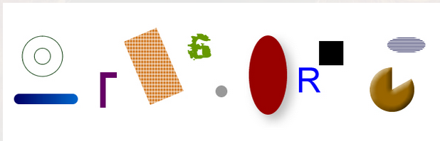
Similarity
Are these item similar?

Slide 19
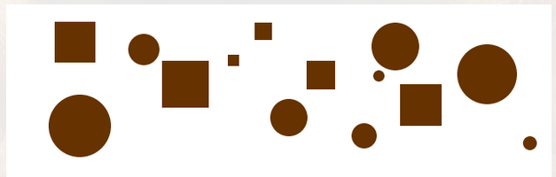
Similarity
What about these?

Slide 20
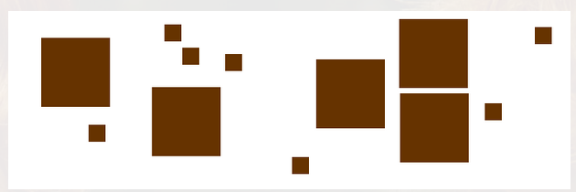
Similarity

Slide 21
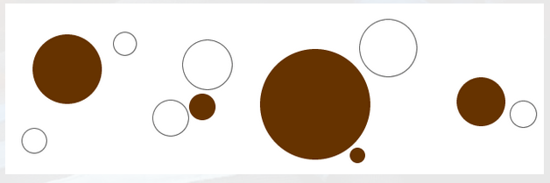
Similarity

Slide 22
Similarity
In designing web pages and applications, its is important to provide visual clues as to which interface elements are related to one another.
So users can quickly perceive organization and make sense of what the designer has created so that they know how to use or interact with it.

Slide 23
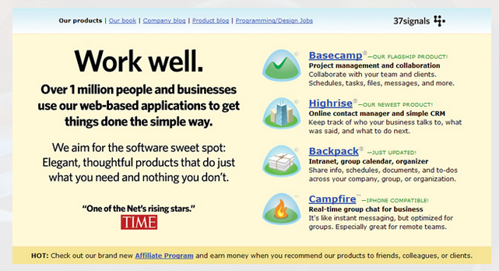
Similarity
http://www.andyrutledge.com/gestalt-principles-2-similarity.php
Notes:
In the example above, the web applications that 37signals offers are shown here using a consistent visual motif. Most conspicuous is the distinct shape and color palette used for the icons, so we immediately perceive that the four bits of information about their web apps are related in some way. If we then read one of the examples, say the top one for Basecamp, we can then immediately assume (correctly) that all of the other entries that are styled and configured in this manner are also web apps offered by 37signals. Here, consistency of styling and presentation indicates consistency of category or context.
Note that this similarity is reinforced by how the apps’ information contrasts strongly with the surrounding content. Because of this contrast and similarity there is no need to structurally “wall-off” these four elements from the surrounding content in order to show their relatedness.

Slide 24
Similarity
Perceiving similarities not only helps us to assume what elements in a layout are related to one another,
it also then implies structure based on the patterns that emerge, as demonstrated by the following examples

Slide 25

Similarity

Slide 26
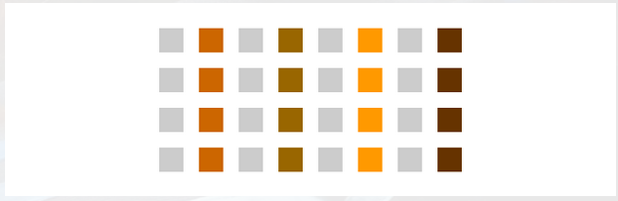
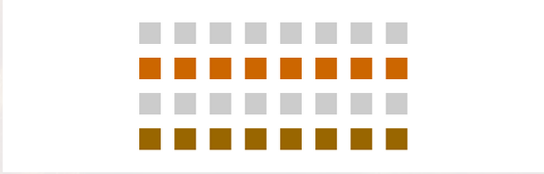
Similarity

Slide 27

Similarity

Slide 28
Similarity
In these examples, color (or more fundamentally, contrast) has been used to imply relationships and create structure

Slide 29
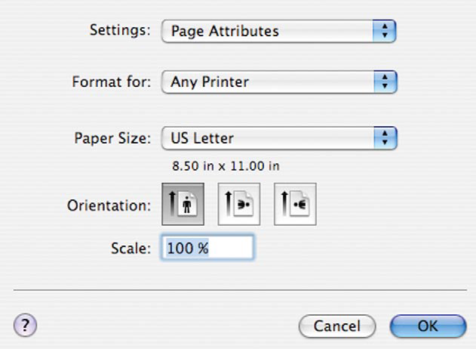

Similarity

Slide 30
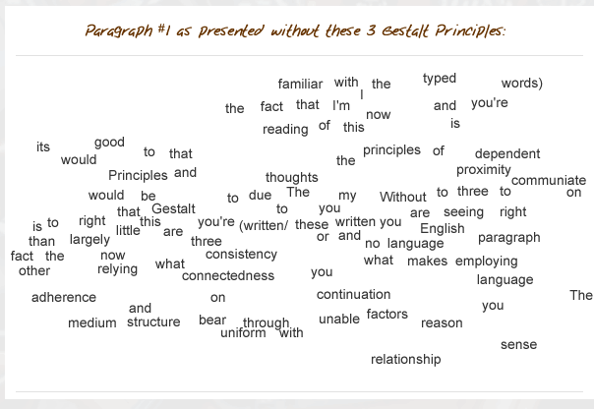
Proximity, Uniform Connectedness, and Good Continuation

Slide 31
Proximity, Uniform Connectedness, and Good Continuation
Lets look at each one of the above in detail.

Slide 32
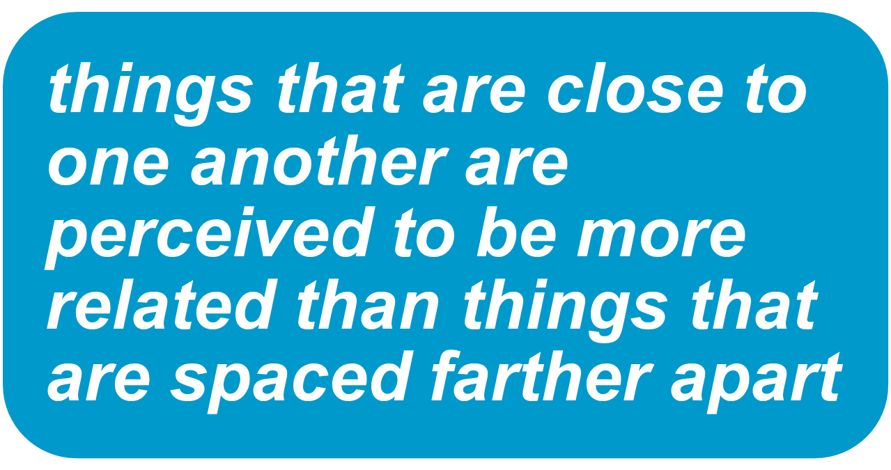
Proximity, Uniform Connectedness, and Good Continuation --Proximity

Slide 33
Proximity, Uniform Connectedness, and Good Continuation--Proximity
All of us intuitively understand that the simplest way to indicate relatedness is to manipulate proximity.
What we might not intuitively understand, however, is how powerful the principle of proximity is.

Slide 34
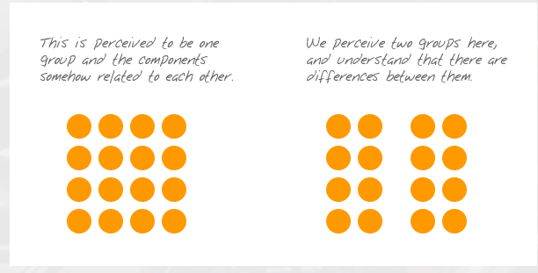
Proximity, Uniform Connectedness, and Good Continuation--Proximity

Slide 35
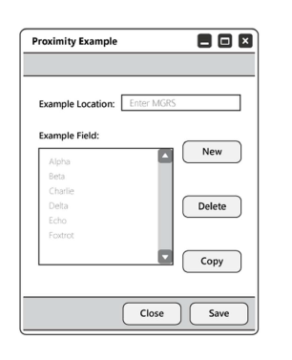
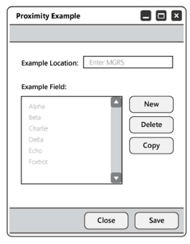
Proximity, Uniform Connectedness, and Good Continuation--Proximity

Slide 36
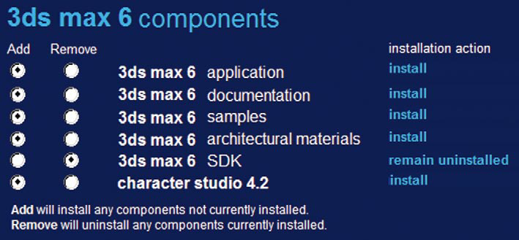
Proximity Principle Violated

Slide 37
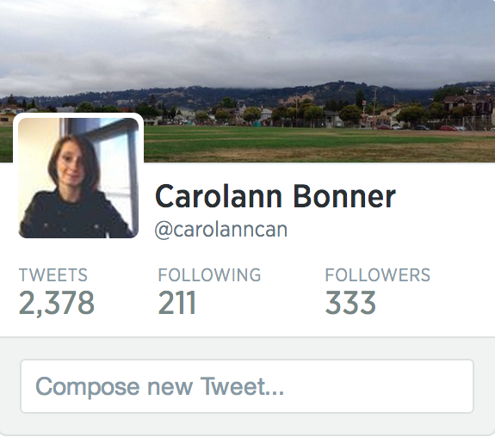

Slide 38
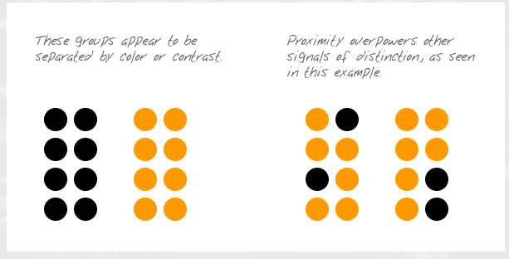
Proximity, Uniform Connectedness, and Good Continuation--Proximity

Slide 39
Proximity, Uniform Connectedness, and Good Continuation—Uniform Connectedness
elements that are connected by uniform visual properties are perceived as being more related than elements that are not connected.

Slide 40
Proximity, Uniform Connectedness, and Good Continuation—Uniform Connectedness
As with the principle of proximity, uniform connectedness causes us to perceive groups or chunks rather than unrelated, individual things..

Slide 41
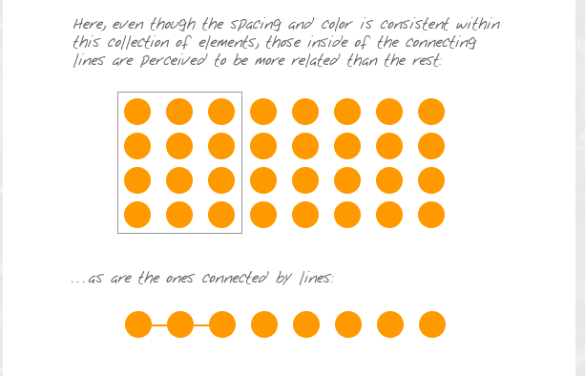
Proximity, Uniform Connectedness, and Good Continuation—Uniform Connectedness

Slide 42
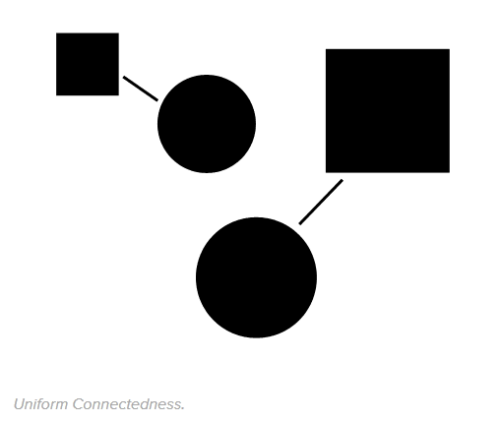
Proximity, Uniform Connectedness, and Good Continuation—Uniform Connectedness

Slide 43
Proximity, Uniform Connectedness, and Good Continuation—Good Continuation
elements arranged on a line or curve are perceived to be more related than elements not on the line or curve

Slide 44
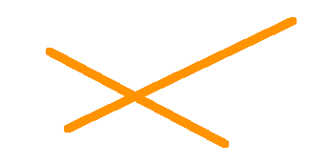
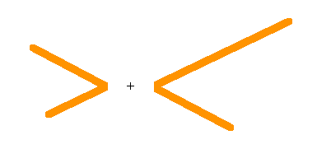
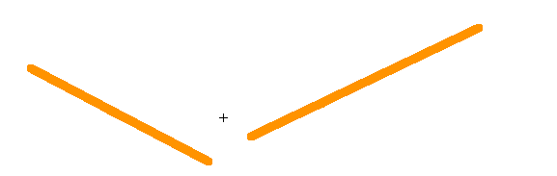
Proximity, Uniform Connectedness, and Good Continuation—Good Continuation
OR

Slide 45
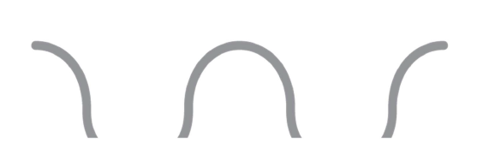
Proximity, Uniform Connectedness, and Good Continuation—Good Continuation

Slide 46
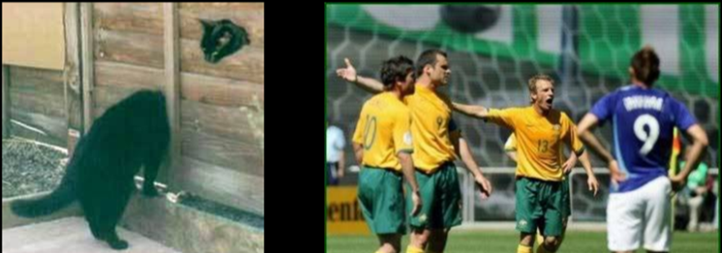
Proximity, Uniform Connectedness, and Good Continuation—Good Continuation

Slide 47

Proximity, Uniform Connectedness, and Good Continuation—Good Continuation

Slide 49
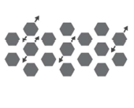
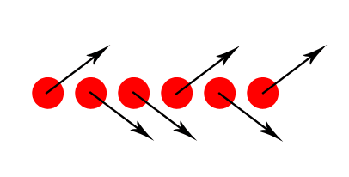
Common Fate
“Elements that move in the same direction are perceived as more related than elements that are stationary or that move in different directions.”

Slide 50
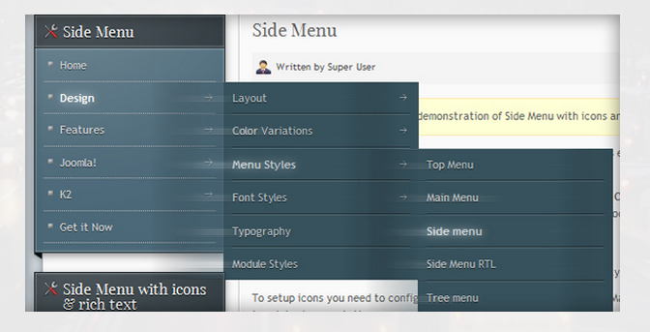
Common Fate

Slide 51
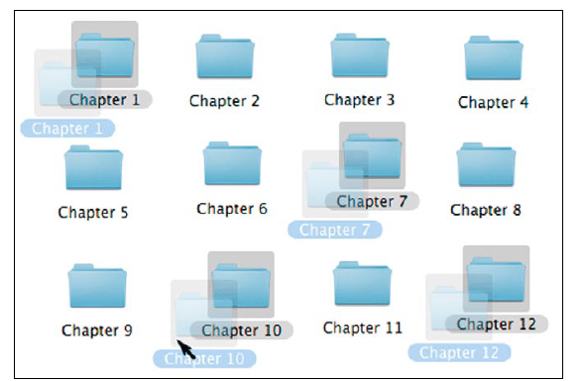
Common Fate

Slide 52
Closure
When looking at a complex arrangement of individual elements, humans tend to first look for a single, recognizable pattern.

Slide 53
The degree to which the principle of closure works is inversely proportional to the effort required to make it work

Slide 54
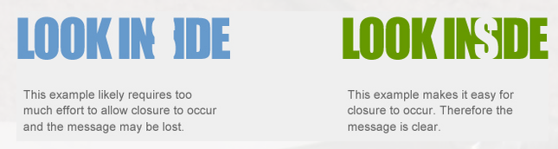
Closure

Slide 55


Slide 56
Try These—Can you read them?
Th prchas of a hme s lkely th sngle mst mprtant fnancl dcisn y’ll evr mke.
Ofur recso nad venes eyasr gao…
Notes:
87 years ago

Slide 57
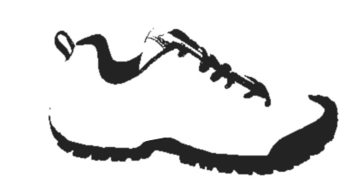
Closure

Slide 58

Closure

Slide 59
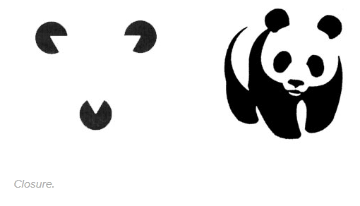
Closure
Notes:
On the right image, you see a panda even though the figure is several random shapes. Seeing the triangle and panda is simpler than trying to make sense of the individual parts.

Slide 60
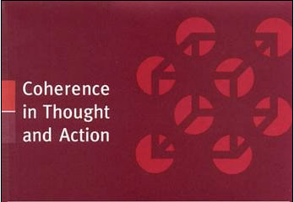
Closure

Slide 61
Symmetry & Order
“People tend to perceive objects as symmetrical shapes that form around their center.”

Slide 62
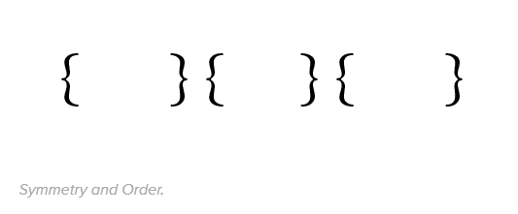
Symmetry and Order
What does the principle of proximity say?

Slide 63

Symmetry
This logo is perceived as an integral whole although the two constituent geometrical shapes seem to be pointing in different directions and have differing colours.

Slide 64
Focal Point
“Elements with a point of interest, emphasis or difference will capture and hold the viewer’s attention.”

Slide 65
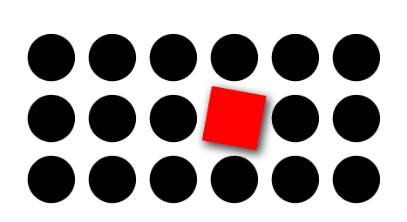
Focal Point

Slide 66
• Our visual system will try to resolve ambiguity, overly complex user interface designs are often misread by the user
• A strong understanding of Gestalt principles can help produce interface designs that are accurately read and understood by the user
• In most interface designs, multiple principles interact in concert. Understanding and screening designs for this will help avoid unintended
visual relationships

Slide 67
• Applying Gestalt principles is a good method for ensuring a clear hierarchy in your interface layout and visual flow, resulting in a better experience for the user
• Users are goal driven, understanding and applying Gestalt visual principles can result in easier, more accurate and efficient task execution

Slide 68
References / Reading list
http://www.andyrutledge.com/gestalt-principles-2-similarity.php (Most from this link)

